Slide 1
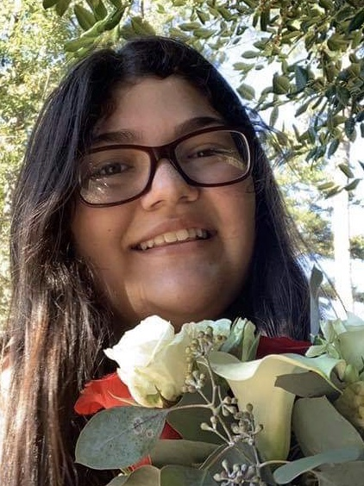
SPARTAN
Student: Alexis Keeney
Art’s Department: Drama
Alexis is currently a senior at Athens Academy. She is an active member of the Drama Department and has appeared in several ACAD theatre/film productions. By seeing her onstage now, you would never know that Alexis began her theatre journey as a shy, backstage worker. Alexis is also an active member of the Drama Club. “Alexis is the group Communications Coordinator. If any thing is going on in the Drama Department, you can rest assured that Alexis has put out the word.” reflected Drama Director, Lorraine Thompson, “Alexis is a fantastic leader and problem solver. Her positive attitude cannot be beat!” Alexis is also a member of the new ACAD service group, The Peer Support Project.

