Slide 1
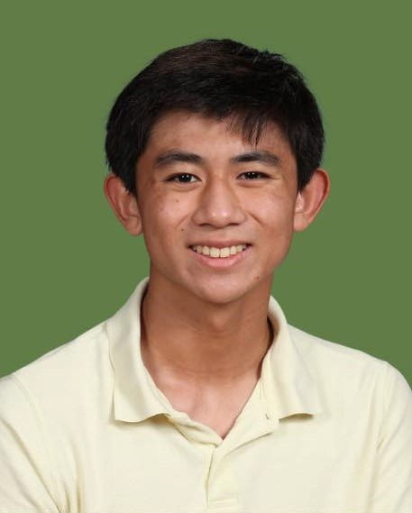
SPARTAN
Spotlight
Student: Daniel Huang
Department: Music
About: Daniel is currently a senior at Athens Academy and a valuable member and leader of the US Orchestra’s violin section. In addition to his dedication and service to the orchestra program, Daniel finds the time to take private violin lessons and recently won a position in the violin section of the 2022 All-State Orchestra. Daniel is a member of the Tri-M Music Honor Society and is currently serving as vice president of Athens Academy’s chapter.
“Daniel is a is a first-rate musician - a real asset to our school orchestra program”!
Debbie Schab, Music Department Chair

